Slide 1
Secure data hiding in images using steganography
CAPSTONE PROJECT
Presented By
Student Name : Safeera V
College Name & Department : Jansons Institute of Technology& Computer Science and Engineering

Slide 2
OUTLINE
Problem Statement
Technology used
Wow factor
End users
Result
Conclusion
Git-hub Link
Future scope

Slide 3
Problem Statement
This project focuses on securely embedding confidential data within images using steganography techniques.
It ensures data privacy by hiding information in image pixels, making it nearly undetectable.
The system prevents unauthorized access and enhances secure communication over digital platforms

Slide 4
Technology used
Programming Language: Python
Libraries: OpenCV, CV2,String
Platform: Jupyter Notebook, VS Code

Slide 5
Wow factors
Uses LSB (Least Significant Bit) Steganography for high security.
Supports encryption before hiding the data for added protection.
Ensures undetectability, making extraction by attackers highly difficult.
Can be implemented for real-time secure messaging.

Slide 6
End users
Cybersecurity professionals
Journalists and whistleblowers
Military and government organizations
Individuals needing secure communication

Slide 7
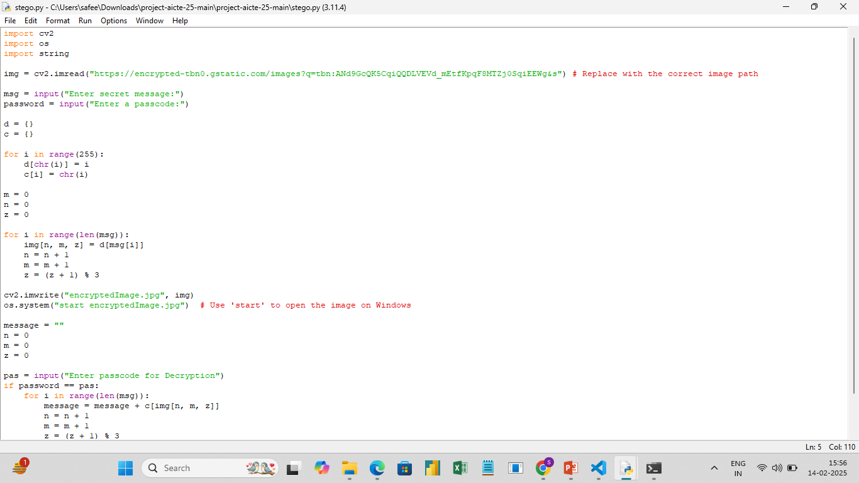
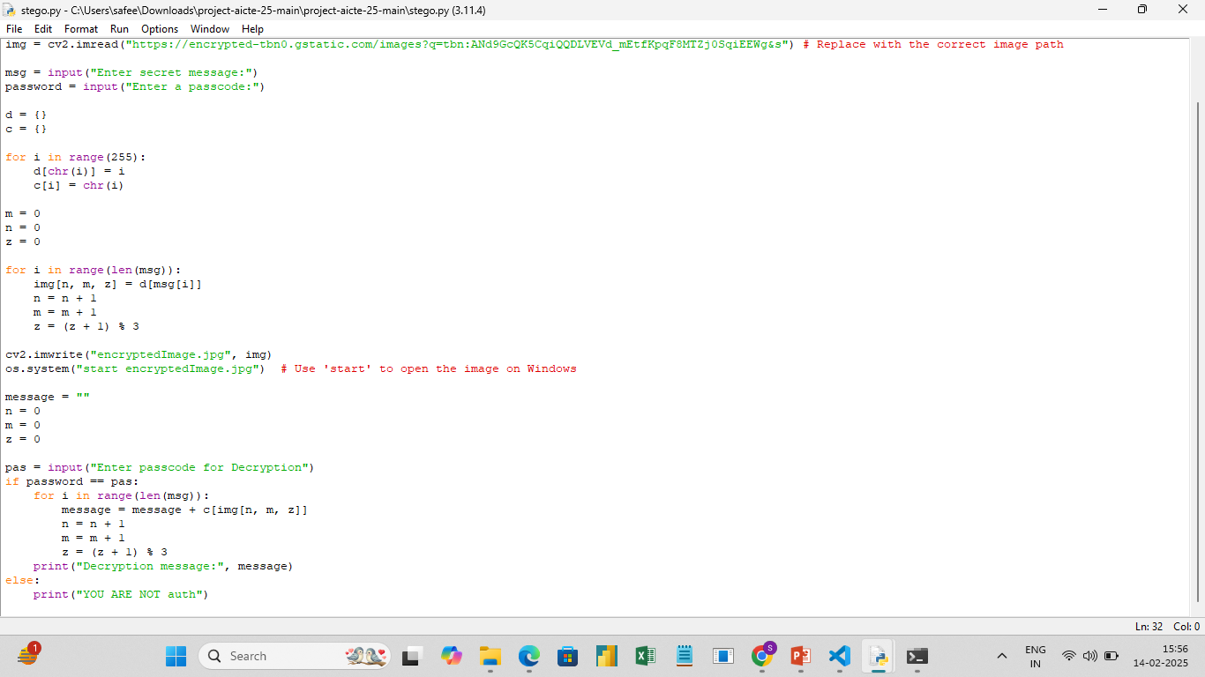
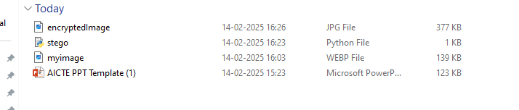
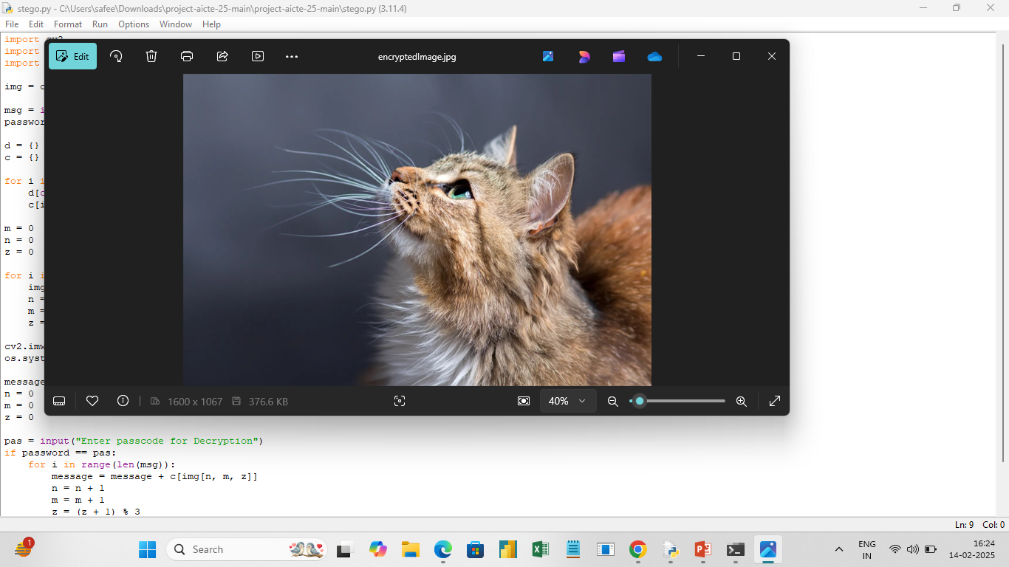
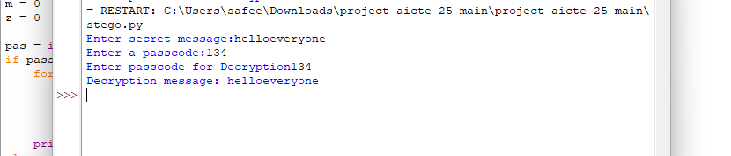
Results

Slide 8
Conclusion
This project successfully enhances secure data transmission by embedding secret information into images without altering their appearance. It offers a practical and effective solution for digital privacy concerns.

Slide 9
GitHub Link
https://github.com/Safeera07/Aicte-project.git

Slide 10
Future scope
Implementing AI-based steganalysis resistance to prevent detection.
Extending support for audio and video steganography.
Developing a mobile application for on-the-go secure communication.
Enhancing security with quantum cryptography techniques.

Slide 11
THANK YOU

